Slide 1
Software Debugging
By: Debanjan chakraborty

Slide 2
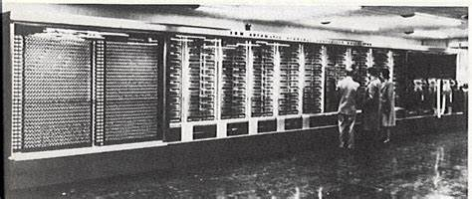
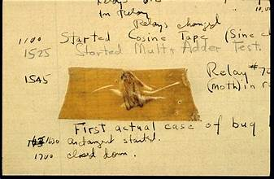
BUG
Where does the term bug come from?
Moth at the Smithsonian at Washington
harvard mark 2
September 9, 1947

Slide 3


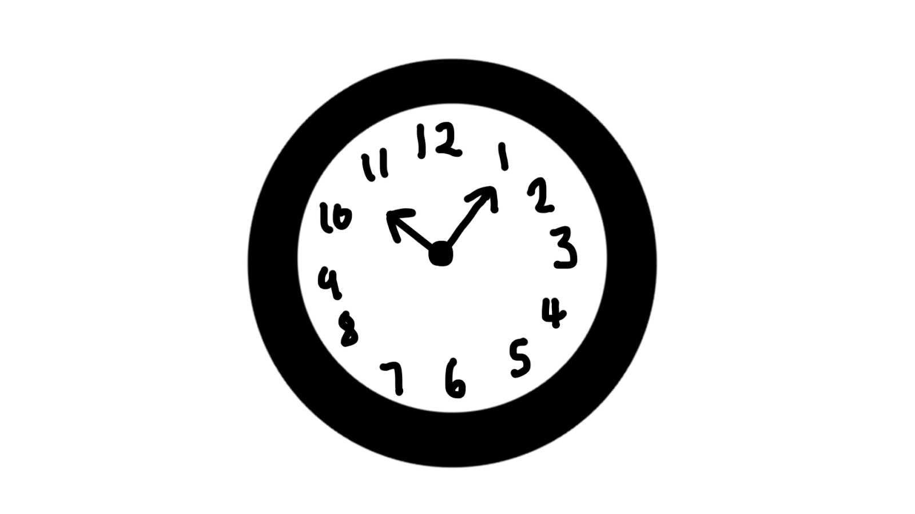
LATE NIGHT DEBUGGING
👩
😵
😊

Slide 4
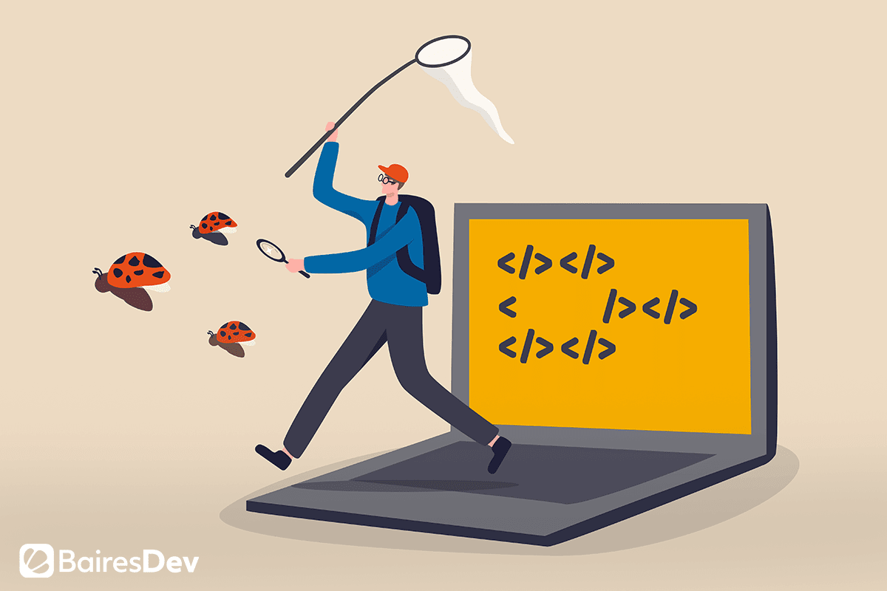
HOW DEBUGGERS WORK
Explore the basics of debugging
Build a simple debugger in python

Slide 5
REMOVE HTML MARKUP
HTML
TEXT
Remove the tags and give the output as only the text
Example:
<b>foo</b> o/p: foo
!tag
!<
>
<
tag
!>

Slide 6
NOW WE SEE THE CODE
E:\projects\debugging.py

Slide 7
IS THE CODE PERFECT?
QUIZ:
WHICH OF THESE INPUTS IS NOT PROPERLY STRIPPED?
<em>foo</em>
<a href=“foo.html”>foo</a>
<a href=“”>foo</a>
<a href=“>”>foo</a>

Slide 8
NOW WE SEE THE CODE
E:\projects\debugging1.py

Slide 9
A FIRST BUG
INPUT EXPECTED OUTPUT
<a href=“>”>foo</a> foo “foo
!<
!>
!“
>
“
!tag
!quote
Tag
!quote
Tag
quote
<
“

Slide 10
NOW WE SEE THE CODE
E:\projects\debugging2.py

Slide 11
IS THE CODE PERFECT?
QUIZ:
WHICH OF THESE INPUTS STILL PRODUCES OUTPUT WITH HTML MARKUP?
<b>foo</b>
<b>”foo”</b>
“<b>foo</b>”
<“b”>foo</”b”>

Slide 12
NOW WE SEE THE CODE
E:\projects\debugging3.py

Slide 13
THE DEVILS GUIDE TO DEBUGGING
INPUT EXPECTED OUTPUT
“<b>foo</b>” “foo” <b>foo</b>
PRINT STATEMENT

Slide 14
NOW WE SEE THE CODE
E:\projects\debugging4.py

Slide 15

NIGHTMARE
NOW CAN YOU IMMEDIATELY SEE WHAT IS GOING ON HERE?
IMAGINE A 1000-CHARACTER INPUT HERE.
THEN IT BECOMES A MAINTENANCE NIGHTMARE.

Slide 16

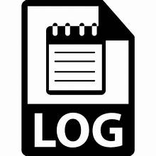
SECURITY NIGHTMARE
😃
password
you
😈
attacker
10.7.2

Slide 17
NOW WE SEE THE CODE
E:\projects\debugging1.py

Slide 18
DO NOT TRY TO DEBUG THIS WAY
REMOVING ALL THE STATEMENTS WHERE THE ERROR IS HAPPENING.
THIS IS THE RIGHT WAY TO DEBUG BUT NOW I WANT TO RETURN TO MY PREVIOUS STATE.
BUT I DIDN’T HAVE A BACKUP OF MY PREVIOUS CODE SO NOW WHAT?
TIMES LIKE THIS ARE WHEN CODE MANAGEMENT PLATFORMS LIKE GITHUB SHOW THEIR MAGIC.

Slide 19
THE DEVILS GUIDE TO DEBUGGING-code complete
SCATTER OUTPUT STATEMENTS EVERYWHERE
DEBUG THE PROGRAM INTO EXISTANCE
NEVER BACKUP EARLIER VERSIONS
DON’T BOTHER UNDERSTANDING WHAT THE PROGRAM SHOULD DO
USE THE MOST OBVIOUS FIX – fix the symptom instead of the problem

Slide 20
NOW WE SEE THE CODE
E:\projects\debugging5.py

Slide 21
THE DEVILS GUIDE TO DEBUGGING-code complete
SCATTER OUTPUT STATEMENTS EVERYWHERE
DEBUG THE PROGRAM INTO EXISTENCE TO PROCEED SYSTEMATICALLY
NEVER ALWAYS BACKUP EARLIER VERSIONS
DON’T BOTHER UNDERSTANDING WHAT THE PROGRAM SHOULD DO
USE THE MOST OBVIOUS FIX – fix the symptom instead of the problem FIX THE PROBLEM NOT THE SYMPTOM

Slide 22
BEFORE MOVING ON
QUIZ:
BEFORE APPLYING A FIX, ONE SHOULD?
UNDERSTAND WHAT THE PROBLEM IS
UNDERSTAND WHAT THE CODE SHOULD DO
BE ABLE TO PREDICT HOW THE FIX SHOULD ADDRESS THE PROBLEM

Slide 23

HOW FAILURE COMES TO BE
DEFECT VS ERROR
INPUT
ERROR:
NOT CORRECT
NOT RIGHT
NOT TRUE
DEFECT
FAILURE

Slide 24

HOW FAILURE COMES TO BE
INPUT
DEBUGGING IS
IDENTIFY+BREAK
THIS CAUSE EFFECT
CHAIN
PROBLEM IS THESE
STATES ARE HUGE
LARGEST HAYSTACK
ON EARTH
FAILURE

Slide 25
WITH THE ABOVE DISCUSSION IN MIND
QUIZ:
EVERY INFECTION CAN BE TRACED BACK TO A DEFECT THAT CAUSES IT
EVERY EXECUTION OF A DEFECT CAUSES AN INFECTION
EVERY INFECTION ENDS IN A FAILURE
EVERY DEFECT CAN CAUSE A FAILURE

Slide 26
THE SCIENTIFIC METHOD
NOW IT IS TIME TO FIND THE SYSTEMATIC WAY TO FIND THE CAUSES
NOW IT IS TIME TO FIND THE WAY TO ORGANIZE THE DEBUGGING PROCESS
REALITY
TURNING
THEORY
ASPECT
EXPLAINS

Slide 27

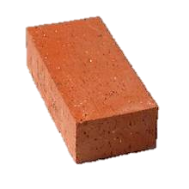


THE SCIENTIFIC METHOD

Slide 28
THE SCIENTIFIC METHOD
INITIAL OBSERVATION
HYPOTHESIS
PREDICTION
REJECT-
CREATE NEW
SUPPORT-REFINE
EXPERIMENT
OBSERVATION
THEORY

Slide 29
QUIZ: WHAT IS A THEORY
A VAGUE GUESS
A FRAMEWORK THAT EXPLAINS AND PREDICTS OBSERVATIONS
A PARTICULARLY USEFUL HYPOTHESIS
THE OUTCOME OF THE SCIENTIFIC METHOD

Slide 30
SO HOW DO WE APPROACH DEBUGGING?
FAILURE
CODE
RUN
MORE RUN
INITIAL OBSERVATION
HYPOTHESIS
PREDICTION
REJECT-
CREATE NEW
SUPPORT-REFINE
EXPERIMENT
OBSERVATION
DIAGNOSIS
THEORY

Slide 31
APPLY THE SCIENTIFIC METHOD
INPUT EXPECTED OUTPUT
<b>foo</b> foo foo
“<b>foo</b>” “foo” <b>foo</b>
WHICH HYPOTHESIS ARE CONSIDERED WITH OUR CURRENT OBSERVATION
SO FAR?
DOUBLE QUOTES ARE STRIPPED FROM THE TAGGED INPUT
TAGS IN DOUBLE QUOTE IS NOT STRIPPED
THE TAG <b> IS ALWAYS STRIPPED FROM THE INPUT
FOUR LETTER WORDS ARE STRIPPED

Slide 32
HYPOTHESIS 1:DOUBLE QUOTES ARE STRIPPED FROM TAGGED INPUT
INPUT EXPECTED OUTPUT
<b>foo</b> foo foo
“<b>foo</b>” “foo” <b>foo</b>
EXPERIMENTATION: Debugging6.py
INPUT EXPECTED OUTPUT
“foo” “foo” foo
“bar” “bar” bar
“” “” empty

Slide 33
THE ERROR IS DUE TO TAG BEING SET
WE WILL USE THE MOST POWERFUL DEBUGGING TOOL CALLED THE ASSERT CONDITION
Debugging7.py
HYPOTHESIS 2: THE ERROR IS DUE TO THE QUOTE CONDITION EVALUATION TO TRUE
Debugging8.py
INPUT EXPECTED OUTPUT
“foo” AssertException foo

Slide 34
SOME HINT WE HAVE
QUOTES ARE STRIPPED FROM THE INPUT
INPUT EXPECTED OUTPUT
‘foo’ ‘foo’ ‘foo’
Debugging9.py

Slide 35
WHAT WE HAVE UPTO THIS POINT
THE CONDITION
C == ‘ ” ’ OR C == “ ‘ “ AND TAG
BECOMES:
TRUE WHEN C == ‘ “ ‘
FALSE WHEN C == “ ‘ “
SOLUTION:
(c == ‘ “ ‘ or c == “ ‘ “) and tag

Slide 36
SO WHAT DID WE DO?
FAILURE
CODE
RUN
MORE RUN
INITIAL OBSERVATION
HYPOTHESIS
PREDICTION
REJECT-
CREATE NEW
SUPPORT-REFINE
EXPERIMENT
OBSERVATION
DIAGNOSIS
THEORY

Slide 37
ALTERNATE HYPOTHESIS: TAGS IN DOUBLE QUOTES ARE NOT STRIPPED
INPUT EXPECTED OUTPUT
“<b>foo</b>” “foo” <b>foo</b>
Debugging10.py

Slide 38

AFTER THE FIX
CHECK WHETHER THE SAME ERROR HAS BEEN MADE ELSEWHERE.
ENSURE THAT TH ERROR DOES NOT OCCUR AGAIN
assert … : tag and not quote

Slide 39

JUST FIX IT
IF YOU ARE A VERY EXPERIENCED PROGRAMMER THEN YOU CAN SEE THE ERROR FROM MILES AWAY IN 100’S LINES OF CODE IN MINUTES
BUT ITS FUN AND GAME FOR 5 MINUTES AND AFTER THAT ITS GONNA GET ON YOUR NERVES

Slide 40
EXPLICIT DEBUGGING
AVOID LATE NIGHT DEBUGGING
START LISTING THE CHANGES IN THE CODE
MAKE NOTE OF THE INPUT, EXPECTED, OUTPUT FORMAT MENTIONED
TALK TO SOMEBODY
TEDDY BEAR METHOD
REMOVE THE BLINDFOLD, EX-MASTERMIND

Slide 41
QUIZ:
WHICH OF THESE STATEMENTS HOLD?
FIX THE BUG AS SOON AS YOU SPOT THE PROBLEM
ALWAYS KEEP ALL DETAILS IN YOUR HEAD
EXPLAINING THE PROBLEM CAN BE HELPFUL
UP TO 50-70% OF SOFTWARE DEVELOPMENT EFFORT IS SPENT ON VALIDATION AND DEBUGGING

Slide 42
THANK YOU

